Slide 1
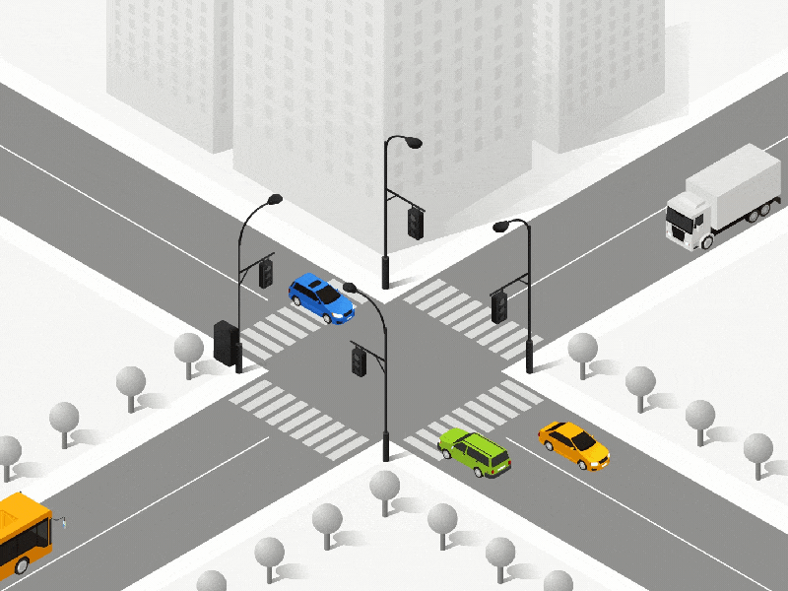
Welcome to our presentation
Cross Traffic Management
Course Tittle: Electronics Engineering A
Team: 5
Members:
Md Akram
Abdullah al Forkan
Ali Hisham
Dapsara Kapuge

Slide 2

Motivation
Ensure Safe and secure Journey
Reduce Road Accident
Savings Travel Time

Slide 3
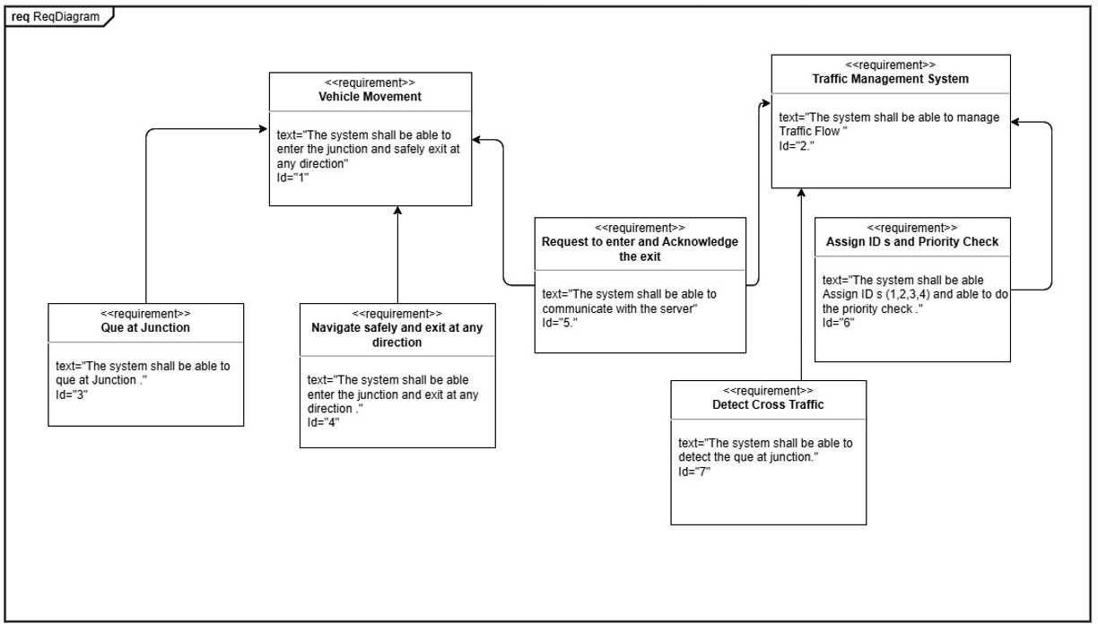
UML Implementation
Requirement Diagram

Slide 4
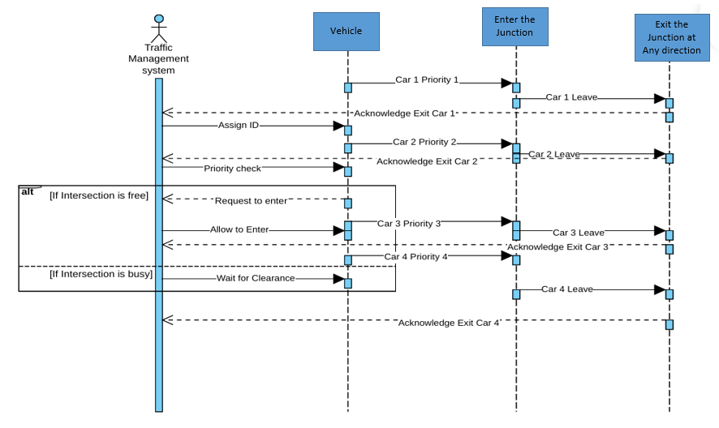
Sequence Diagram

Slide 5
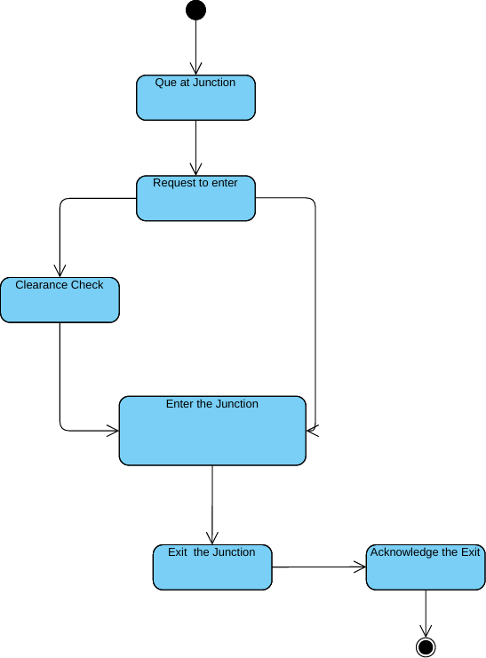
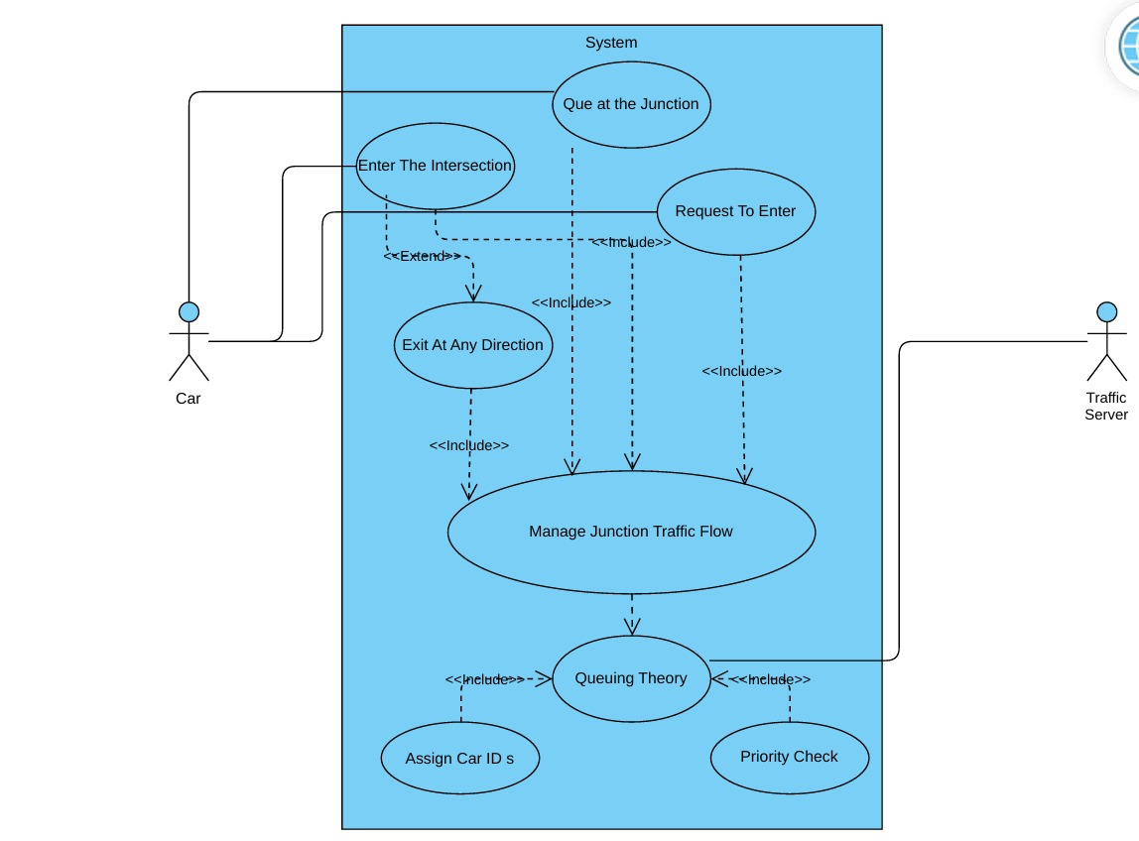
State Machine Diagram
State Machine Diagram
User Case Diagram

Slide 6











Incoming car registration
3
1
Out going car deregistration
4
2
4
2
3
1
Out going car sensor
Sent the clearance signal
Server receive the data
Update the car queue
Incoming car sensor
Sent the direction data to go
Server receive the data
Send signal to queue
Queuing of the cars
Generate.car_id
Push.local_queue
Push.intersection_queue
Give permission to exit
Incoming car registration
Processing in queue
After Server received the data
Safe and secure journey
Out going car deregistration
Receive the clearance signal
Pop.local_queue
Pop.intersection_queue
Delete the car id from server
Processing in queue
Activity diagram to queue cars

Slide 7
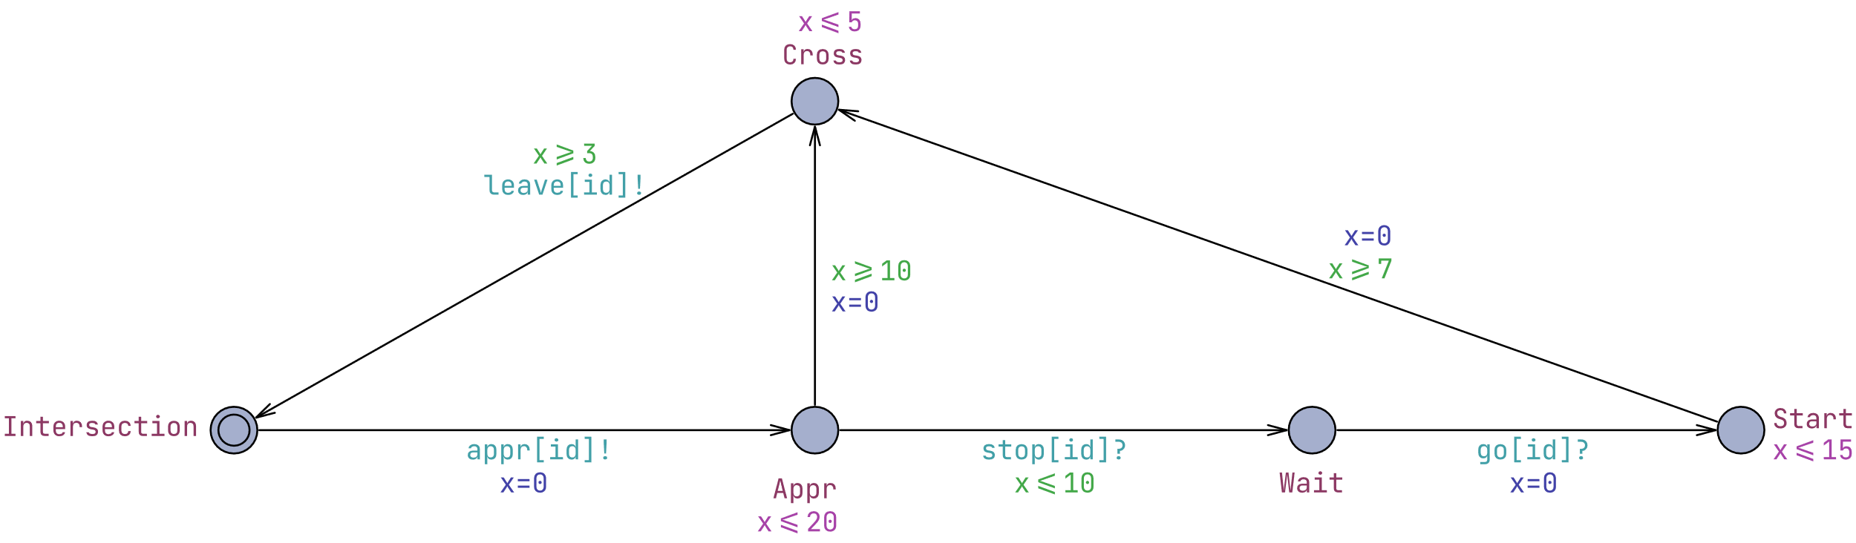
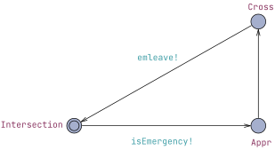
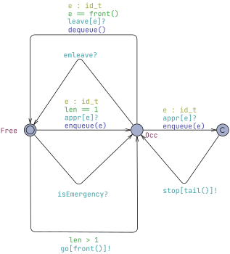
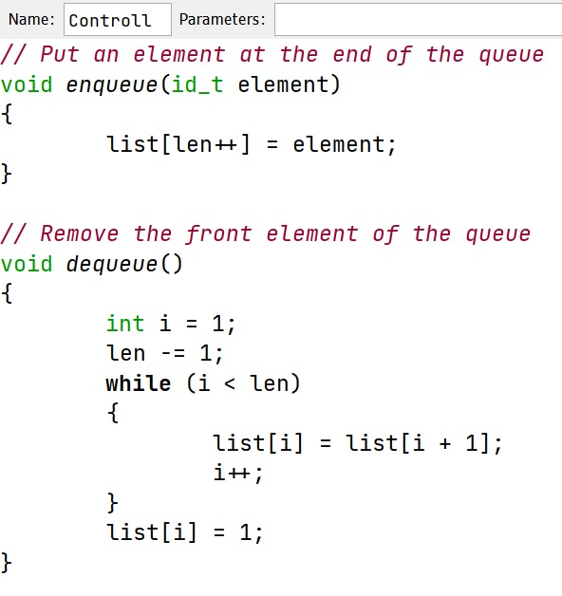
Vehicle
Emergency Vehicle
Server Control
Enqueue & Dequeue

Slide 8
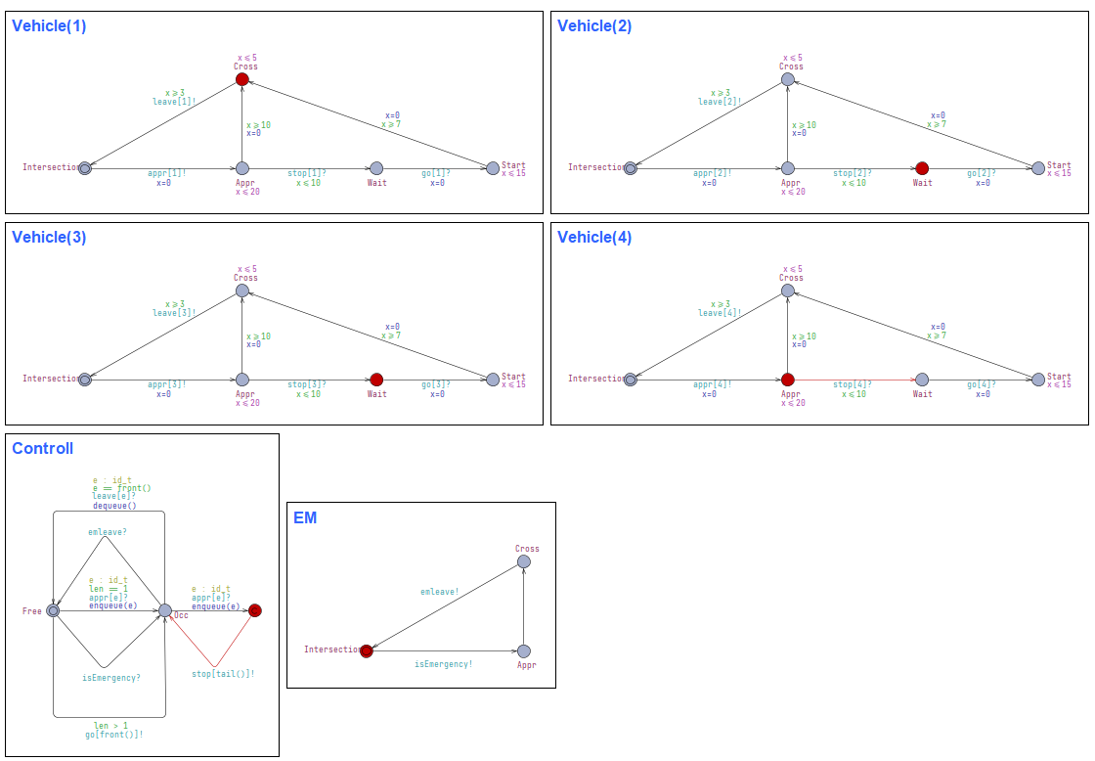
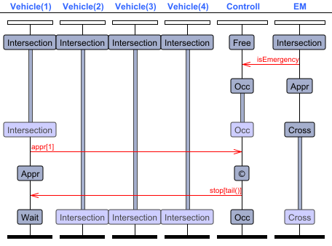
UPPAAL Simulation

Slide 9
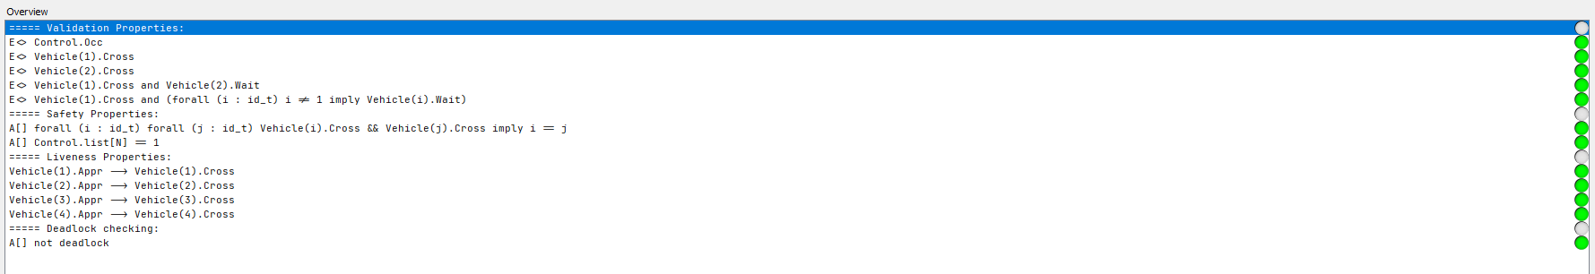
UPPAAL Verify

Slide 10
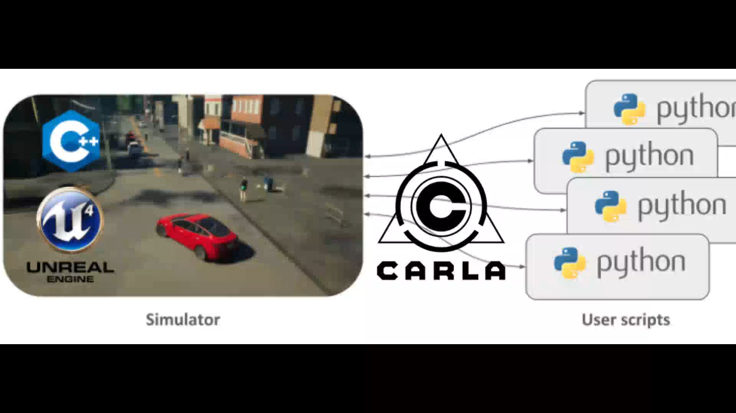

Slide 11
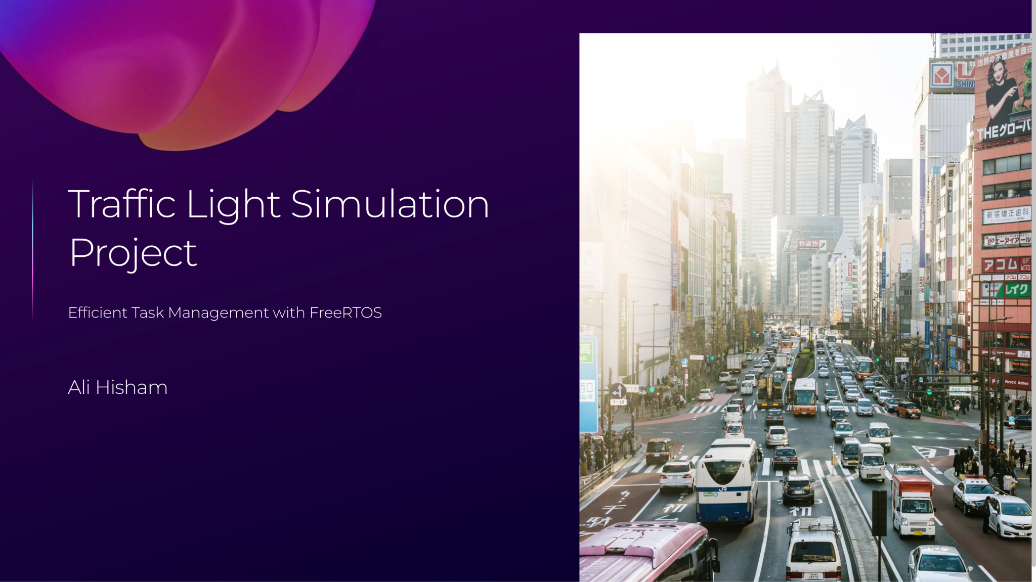

Slide 12
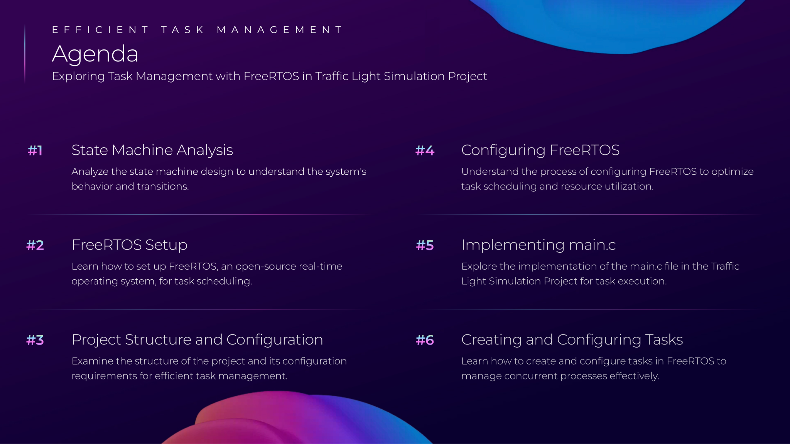

Slide 13
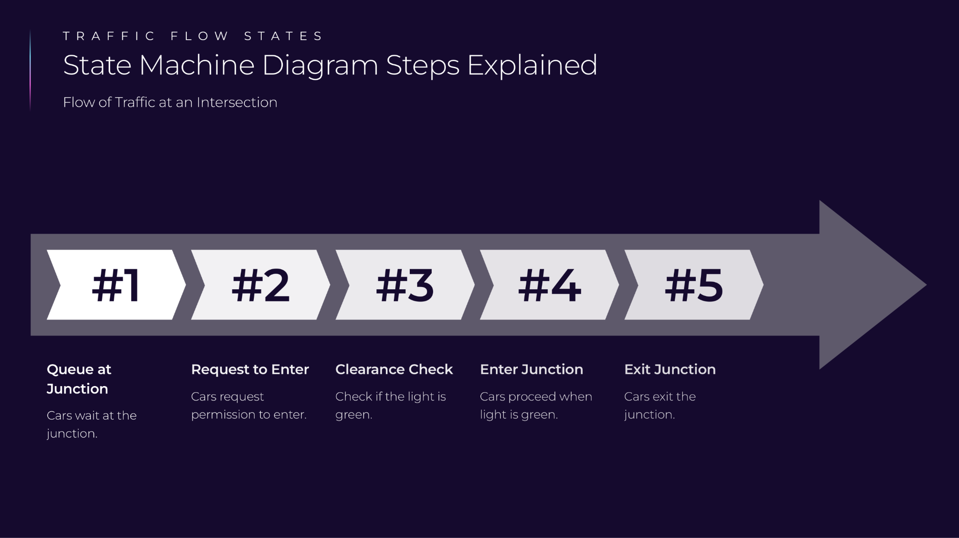

Slide 14
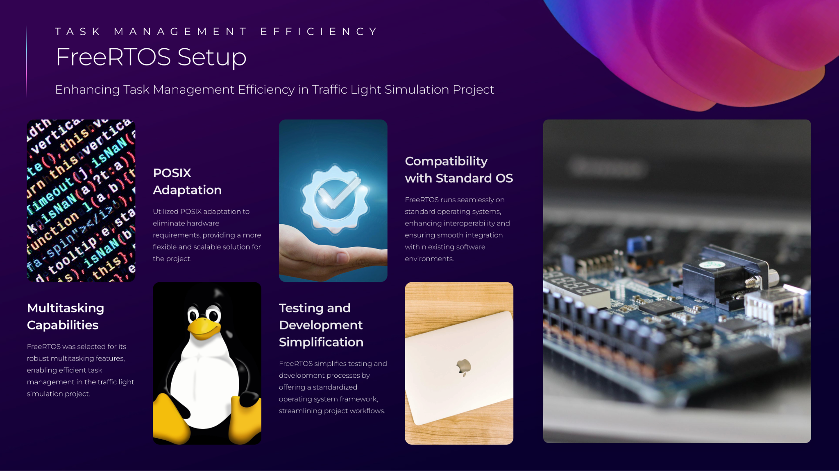

Slide 15


Slide 16


Slide 17
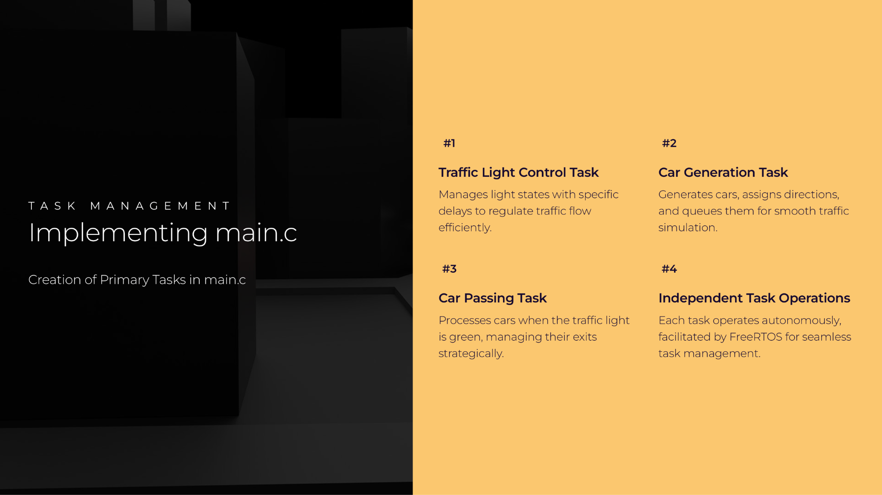

Slide 18
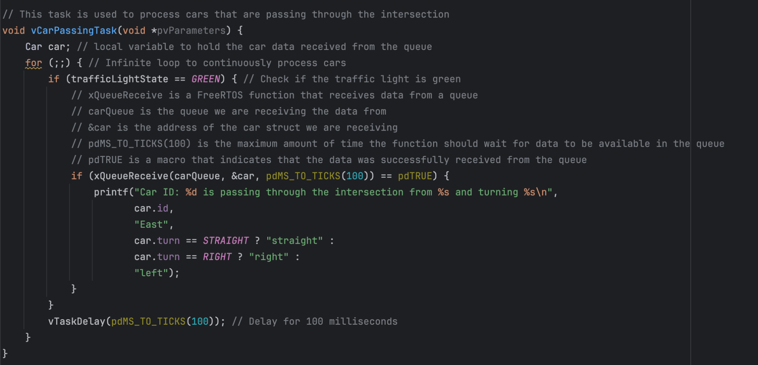

Slide 19
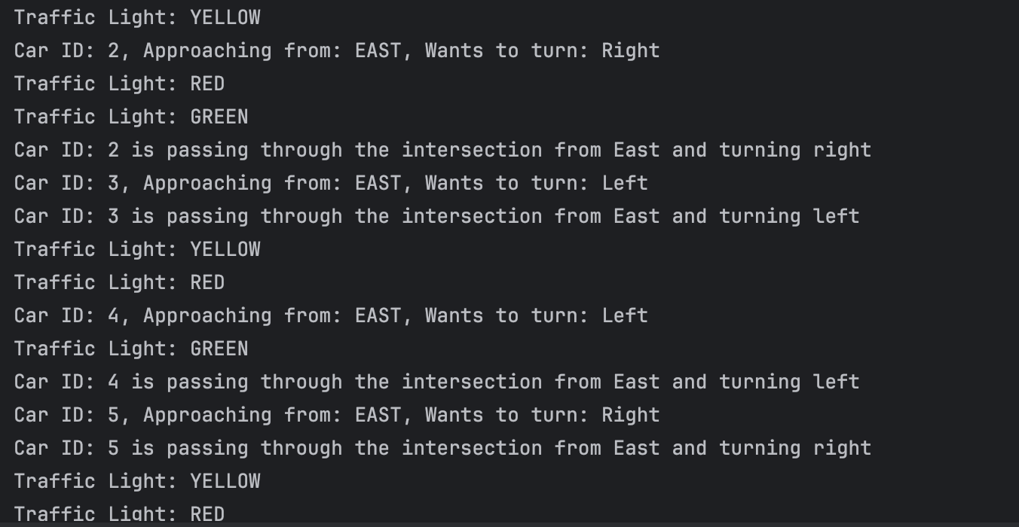

Slide 20
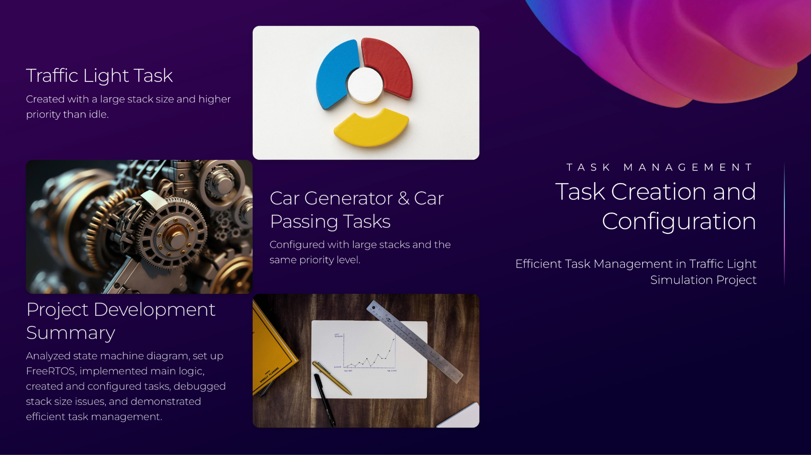

Slide 21
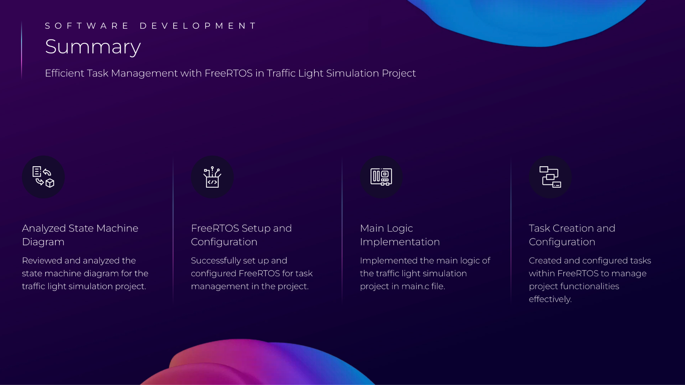

Slide 22
VHDL Implementation
Very High Speed Integrated Circuit Hardware Description Language.
VHDL has many advantages such as:
Portability
Reusability
Simulation and Verification
Design Documentation

Slide 23

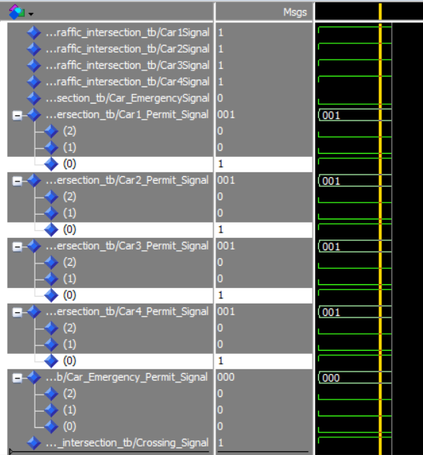


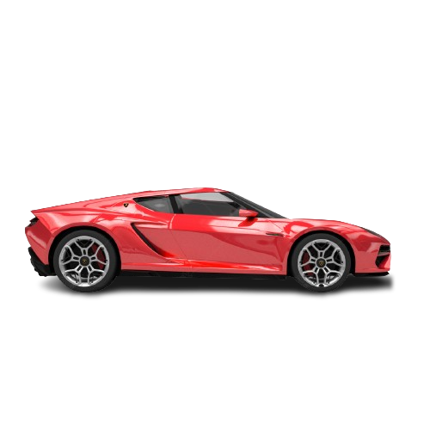

Right direction:
Right
Right
Right
Right

Slide 24
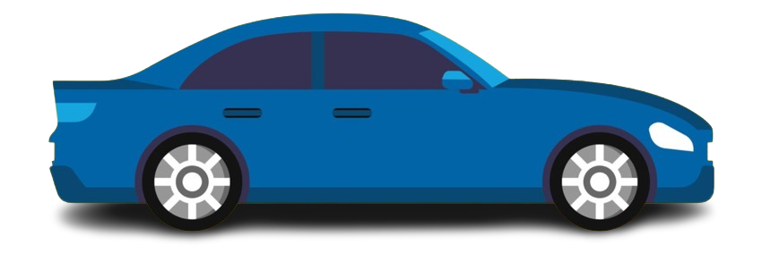

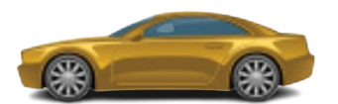
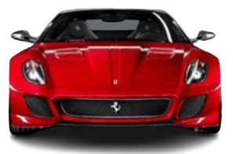
Right direction:
All Car are allow to cross the intersection area without any problem
Right
Right
Right
Right

Slide 25
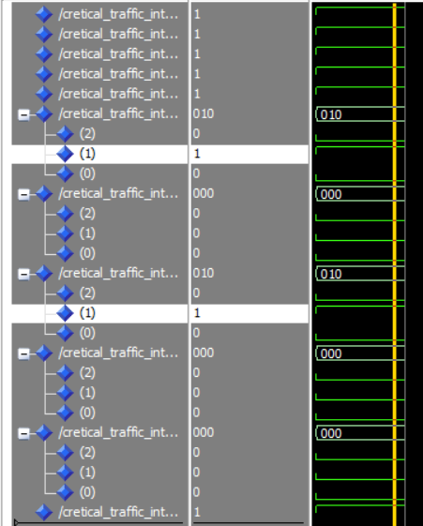

Forward direction:
Only opposite side cars allow to cross the intersection area without any problem
So car 1 and car 3 are crossing
Forward
Forward

Slide 26
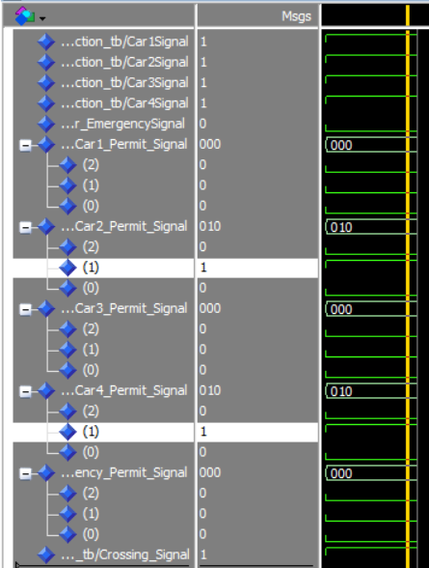
Forward direction:
Car 2 and car 4 are crossing
Forward
Forward

Slide 27
Left direction: There is more problem that’s why we will only allow one car at a time

Slide 28
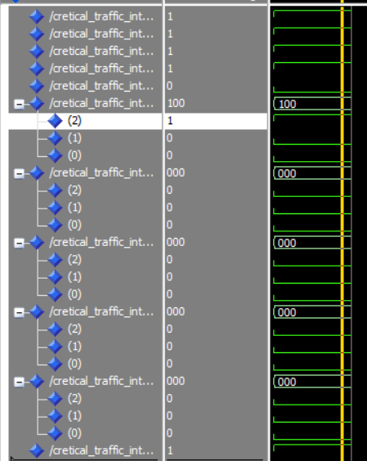
Left direction: Car 1 is crossing
Left

Slide 29
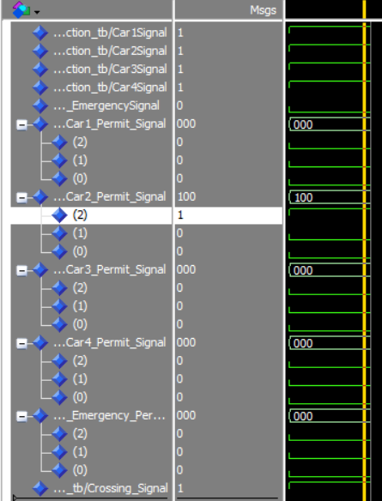
Left direction: Car 2 is crossing
Left

Slide 30
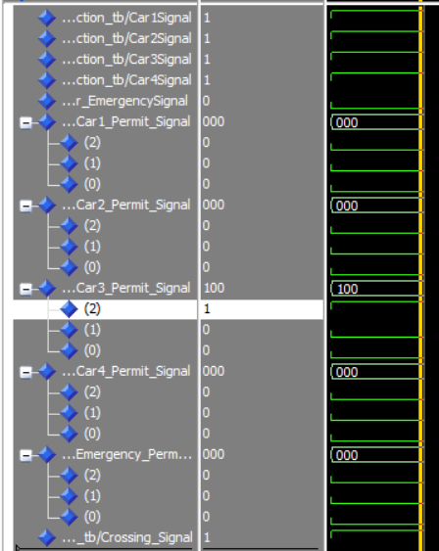
Left direction: Car 3 is crossing
Left

Slide 31
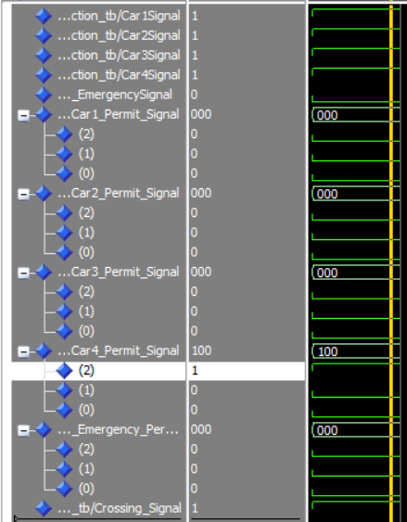
Left direction: Car 4 is crossing
Left

Slide 32
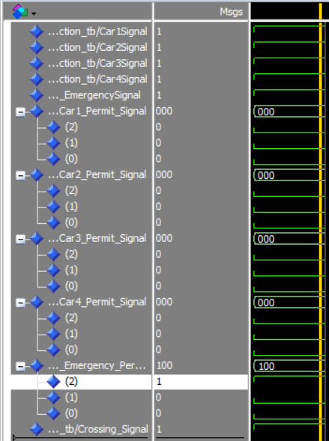
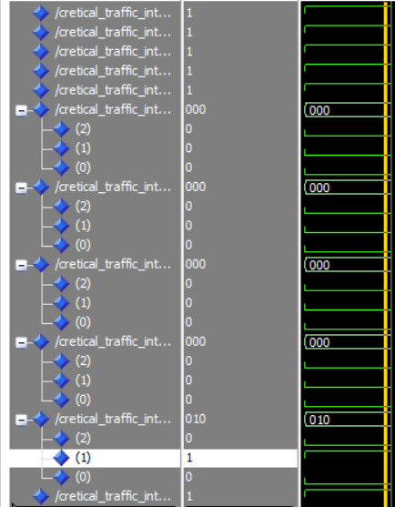
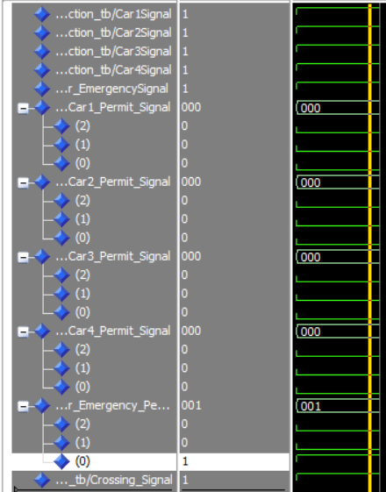
Emergency Car: When emergency car come this time other car is stop and Emergency car are allow to go any direction
Emergency
Emergency
Emergency

Slide 33
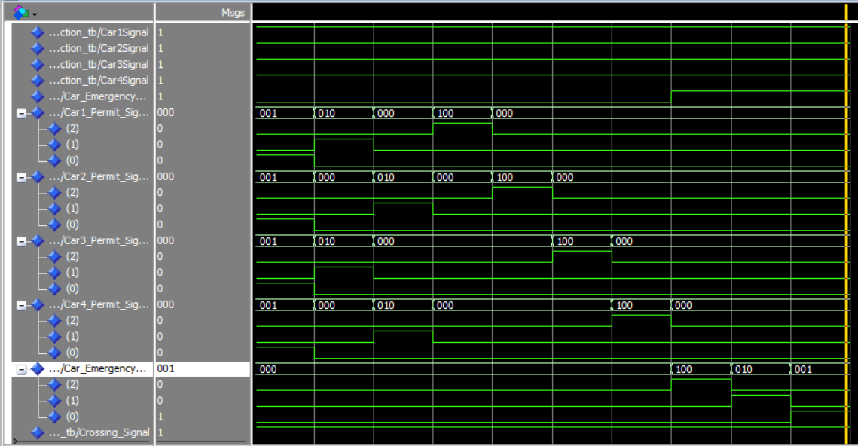
VHDL all scenarios simulation together

Slide 34


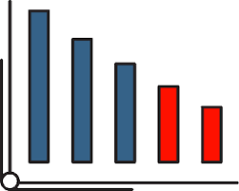
Conclusion
To sum-up, we can see that by applying several methods
We can able to reduce accident and save travel time and we finally ensure save and secure journey

